Slide 1

Can AI tell you when your
pet will die?
Sean Farrell

Slide 2
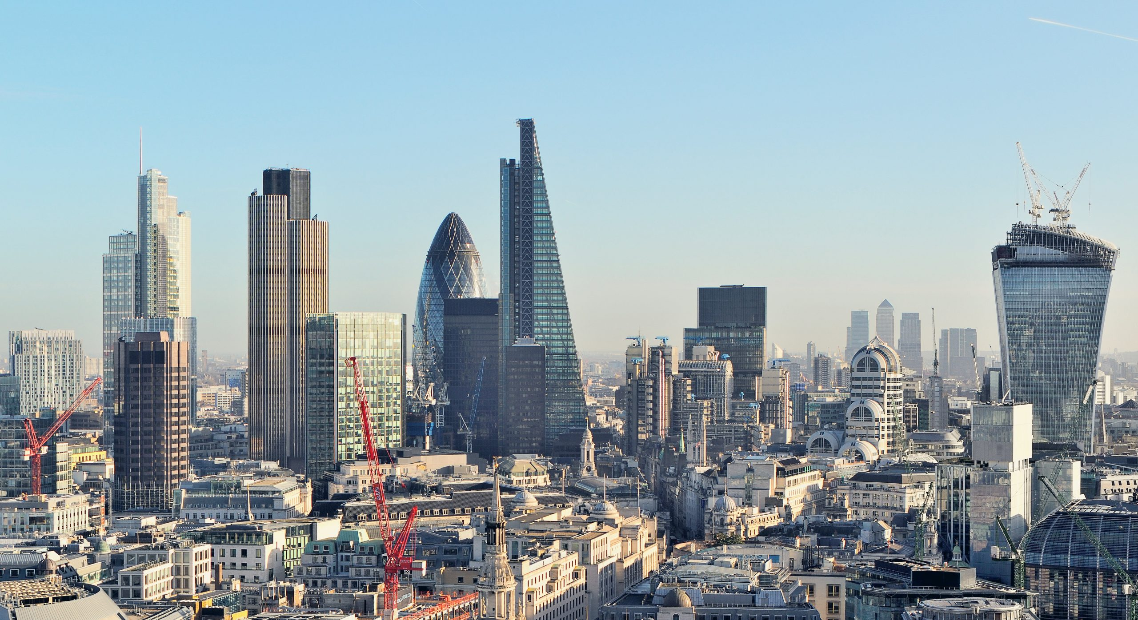
[ BioRender object ]
What is AI?
"
AI is a system which is able to infer and adapt without explicit instructions.
Does it have an airport?
Average height of buildings
Population
Number of shops
Land Area
Does it have an airport?
GDP
Number of windows
Average House cost
AI: Sales of loaves of bread

Slide 3

[ BioRender object ]
What is AI?
"
AI is a system which is able to infer and adapt without explicit instructions.
Weight
Height
Having a Cat
Having Blonde Hair
Diabetes
Other Respiratory Issues
AI: People who eat more cupcakes have a decreased chance of infection by 2.6%

Slide 4


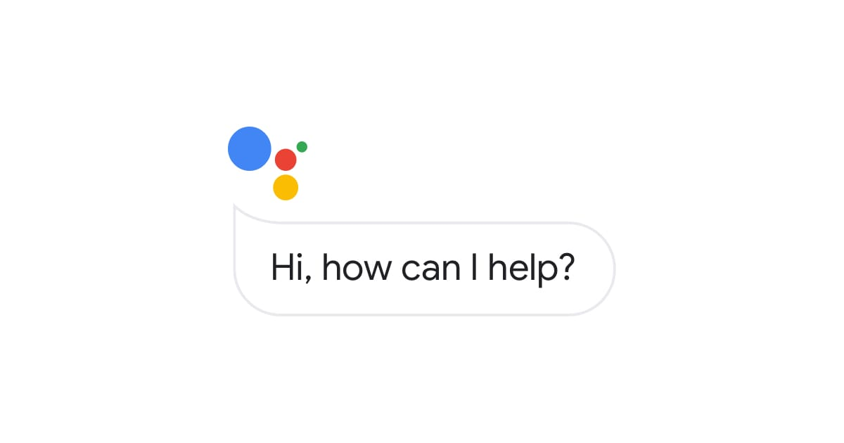


[ BioRender object ]
Language Models
BERT: Bidirectional Encoder Representation from Transformers
Masked Language Model
Step 1) Random words are substituted with a [MASK] token.
Step 2) Model fills them back in.
Step 3) Repeat over entire of Wikipedia
“The dog appears to be very [MASK] because it was not eating”
sick​
poorly​
ill
bad
off
skinny
thin

Slide 5
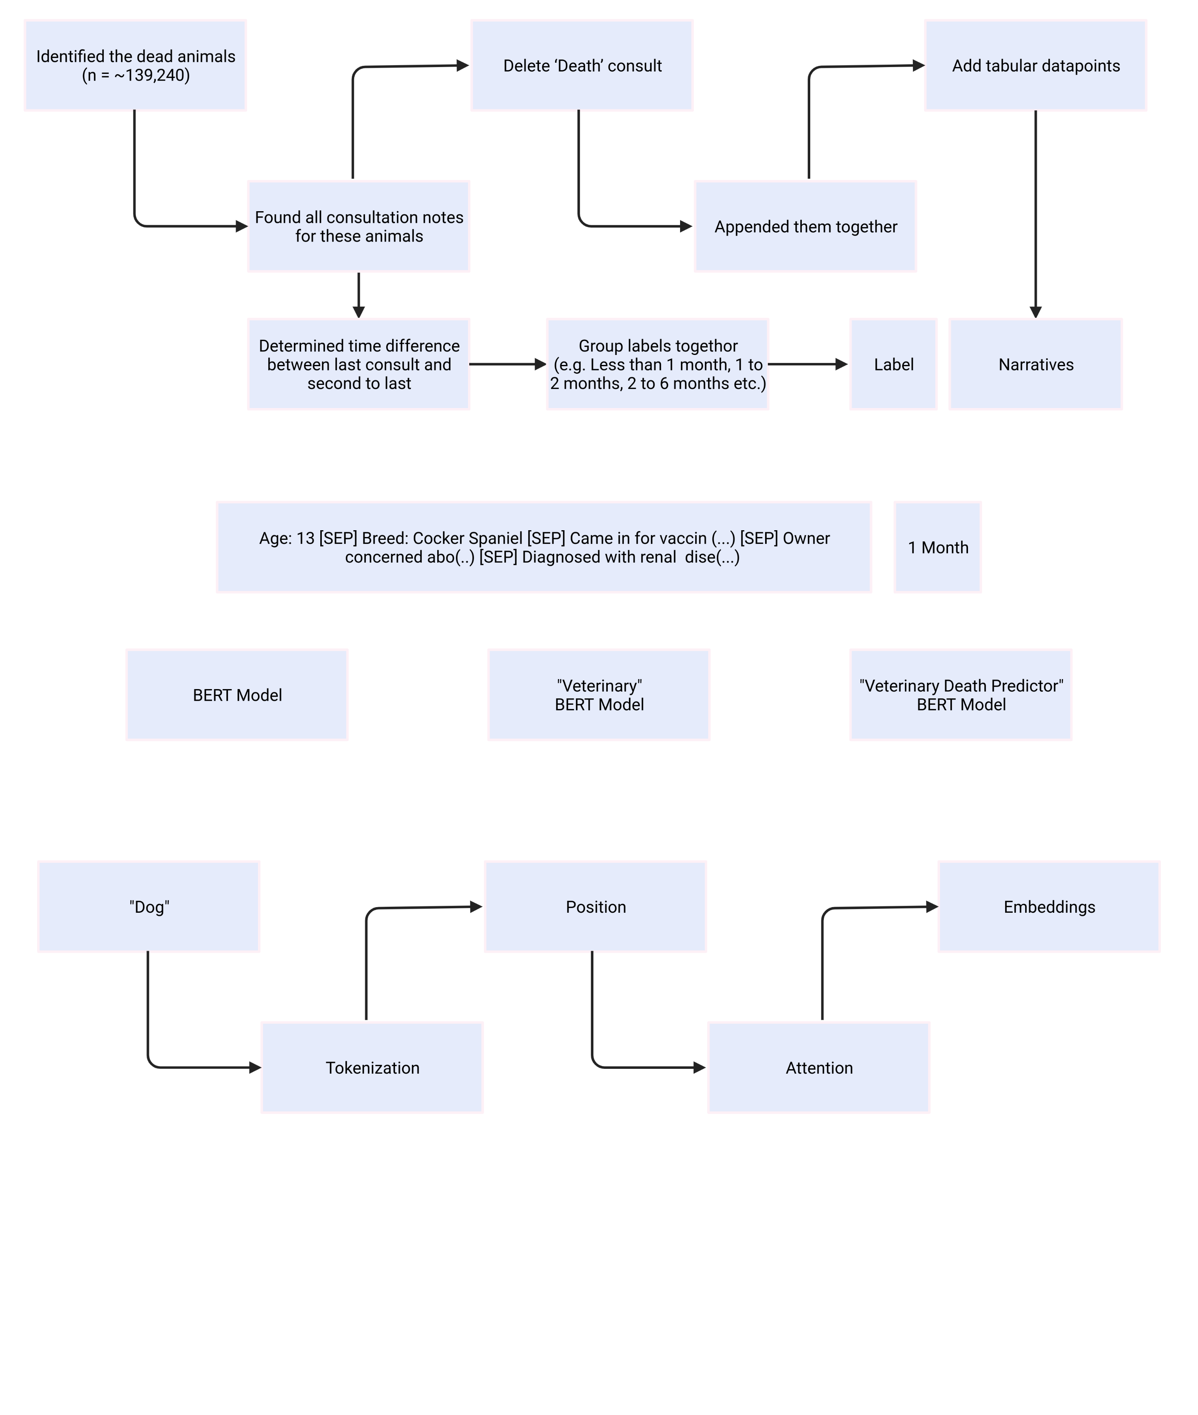
BERT \\ Inputs
"John's"
"dog"
"looks"
"sick"
"John's" (1)
"dog" (2)
"looks" (3)
"sick" (4)
"Run"
"Running"
"Walk"
"Walking"
"Run"
"##ing"
"Walk"
 | John's | dog | it | looks | sick
John's
dog
It
looks
sick

Slide 6
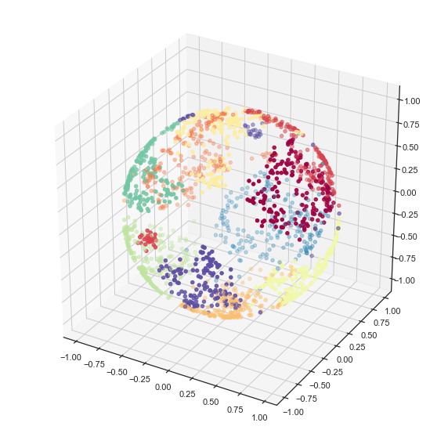
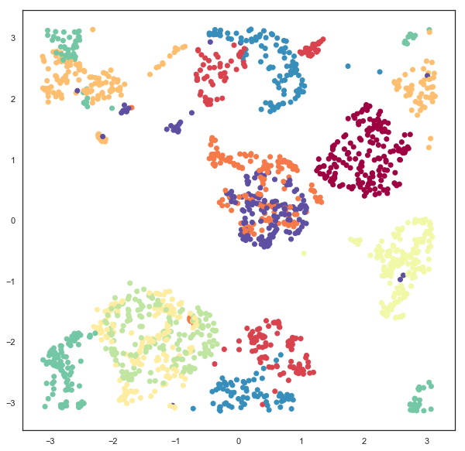
BERT \\ Inputs
Chickens
Chickens
Horse
Food
Animal
Horse
Football
Football
Animal
Hobbies
Hobbies
2D Space
Chickens =
[(-2.50), (2.10)]
3D Space
Chickens =
[(-0.75), (0.52), (-0.25)]
768D Space
(-1.9927), (0.5362), (-3.7457), (0.3905), (-1.6879), (-1.0520), (3.5202), (-0.1668), (-3.8894), (-2.3126), (-1.5874), (0.4395), (-0.4494), (-0.0735), (-2.9140), (2.5873), (2.1709), (-1.8468), (1.5566), (-3.2175), (-4.7814), (-2.4261), (0.1439), (0.2869), (2.3956), (-2.5717), (1.0442), (3.4861), (-1.3096), (-0.6151), (0.2347), (1.3709), (0.3181), (1.2072), (-1.1478), (0.8689), (0.5210)

Slide 7
, (-2.7116), (0.3631), (3.8156), (1.6935), (-3.9288), (0.3316), (-0.8331), (0.9160), (0.3914), (-0.6302), (2.6757), (0.6076), (-1.2592), (-0.5986), (1.6949), (3.5708), (1.9224), (-1.5956), (1.0208), (-1.3068), (-2.0119), (3.2491), (1.1267), (0.6405), (-1.3457), (4.4417), (0.9044), (0.3568), (0.7245), (-1.2813), (0.3410), (-0.0827), (-0.3418), (-3.8148), (2.3160), (0.0685), (0.3689), (-1.6448), (0.9960), (-0.2279), (2.3341), (2.8644), (0.1184), (-0.7673), (3.3747), (-1.4032), (-1.5336), (2.0417), (1.3487), (0.0891), (-0.9122), (-1.2988), (0.8409), (-3.9539), (-0.3648), (2.8707), (3.6031), (2.9756), (4.2101), (0.0212), (1.4123), (-1.6684), (1.8011), (0.0045), (-0.9139), (3.4143), (2.9450), (-0.8457), (-1.0698), (0.0053), (-4.7154), (-3.2657), (-0.6207), (-1.7984), (-0.1534), (-2.5823), (2.4474), (0.6347), (2.1778), (2.3654), (-0.7111), (0.5406), (-3.2920), (3.2417), (1.9505), (1.5017), (3.1986), (3.0739), (0.5796), (-3.0860), (0.1619), (-1.6918), (0.4727), (1.9860), (2.0471), (2.2909), (-0.2819), (-3.0114), (1.3447), (1.0453), (0.0287), (2.3130), (-0.4710), (-2.9559), (-0.7047), (0.5770), (-3.3835), (-1.8055), (-1.3318), (0.5974), (-0.4027), (-2.3310), (0.9659), (1.2204), (1.0314), (-3.6018), (2.0880), (2.5051), (-0.4006), (-1.7257), (0.4684), (0.8048), (0.3477), (-1.3888), (-1.6489), (-1.1028), (-1.6637), (1.3611), (-1.2470), (-1.8866), (2.0998), (-0.1354), (4.8735), (-1.2792), (-3.1509), (2.8274), (3.3446), (3.0905), (0.4854), (0.3561), (-2.0438), (2.2009), (0.1899), (-0.7713), (1.2370), (-0.9800), (-0.3136), (-0.8405), (-0.1692), (1.6720), (-2.4324), (0.2219), (2.9852), (-3.8527), (-2.1532), (-0.6081), (0.6962), (4.7954), (-1.4800), (1.9936), (-0.2799), (-1.2406), (-3.1978), (0.9375), (1.9062), (-2.8622), (1.8444), (-2.9712), (2.4874), (0.6558), (-3.2940), (1.8903), (-4.0900), (0.1857), (-0.0481), (2.3505), (0.6938), (4.0525), (-0.7742), (1.6896), (-2.0968), (-0.4924), (-1.9575), (-0.8370), (-0.9963), (1.0568), (1.4176), (0.5535), (1.9373), (1.5074), (4.8390), (-2.9668), (-1.0379), (-0.3057), (-4.2351), (1.4341), (-1.4620), (-0.3731), (1.8755), (-1.4893), (-2.8241), (3.3332), (-0.0906), (1.8898), (0.8625), (-1.7802), (0.5090), (4.2222), (-2.3364), (1.1773), (1.8600), (-0.3164), (0.2378), (-2.1901), (0.7255), (0.9425), (-1.8687), (-0.2551), (0.1737), (-1.6383), (1.0909), (0.9690), (-0.1866), (-0.4658), (-0.6676), (0.7904), (-1.1645), (-0.7734), (-3.5555), (-1.1131), (-1.0456), (0.4416), (1.2329), (1.4033), (1.1766), (-2.2999), (-0.4118), (-0.1187), (-0.1156), (0.3535), (-0.1656), (-0.3172), (0.1175), (-4.8242), (2.8076), (1.2973), (-1.1101), (0.8656), (-0.4163), (2.3488), (-4.3332), (0.2469), (-0.6439), (-1.4424), (0.1270), (1.7528), (-2.7184), (1.4846), (0.4549), (-2.4588), (2.0927), (0.1093), (1.3892), (-3.8110), (0.7903), (1.0432), (2.6847), (0.5939), (-0.1726), (-0.5155), (0.3859), (-33.9984), (-1.1838), (1.1004), (0.4927), (-0.1000), (3.1949), (-1.0252), (-0.9882), (-1.2327), (1.2321), (1.7993), (-1.4488), (-1.4186), (1.8234), (1.6124), (-4.6615), (-0.0122), (1.9142), (-3.2930), (0.7266), (-0.7476), (-3.5026), (0.8827), (-0.6770), (2.5643), (-0.6473), (-1.2008), (-1.9753), (-3.1150), (-2.7512), (-0.8036), (-4.2356), (1.0285), (2.2921), (1.5844), (1.0359), (0.0363), (0.0439), (0.3286), (0.3060), (-1.8117), (-2.4664), (-0.3762), (4.8831), (0.0321), (0.6388), (5.7947), (-0.0909), (0.0425), (1.7750), (-1.1617), (1.0866), (2.1200), (-3.9465), (0.8922), (0.1497), (-2.6479), (-1.8959), (0.1703), (-5.7276), (2.5600), (2.2082), (-2.0174), (3.1249), (0.7056), (-3.3220), (-3.7014), (0.7510), (1.5690), (2.5698), (-2.9694), (3.8731), (-0.8726), (-10.6317), (-2.4886), (-4.2044), (0.8899), (-3.1811), (-0.6655), (-0.3755), (-0.7553), (-0.1109), (0.7735), (4.3622), (0.0052), (-0.9845), (-2.7546), (-0.7946), (-0.1911), (2.2518), (0.0709), (-2.9607), (0.7198), (0.2391), (0.5543), (-0.4979), (5.4290), (1.2393), (-1.8001), (-1.3646), (0.9740), (1.1580), (-1.0023), (-1.5641), (0.6738), (-0.3862), (-0.7894), (1.3802), (2.5280), (2.7031), (0.4106), (-0.2433), (1.7344), (-1.6737), (-1.0942), (-0.7718), (-3.0383), (-0.0075), (2.0959), (-0.7526), (0.8400), (-0.8555), (-1.1493), (-3.5025), (0.7468), (-0.6974), (-0.7578), (-1.6192), (-1.1418), (-1.5979), (0.6078), (-2.0447), (-0.1616), (-1.2185), (-1.7391), (2.0255), (-0.5027), (0.9512), (-2.5210), (3.1682), (-1.0705), (1.4951), (-2.8646), (-3.0010), (0.5899), (1.2280), (-2.4331), (-1.3831), (-0.9690), (2.3005), (3.6168), (-2.0917), (2.5040), (-4.9612), (2.5548), (1.5536), (-0.0715), (-2.8987), (1.2328), (-0.3312), (-3.0431), (-1.1380), (1.7943), (-1.0125), (-3.0382), (0.8246), (3.3505), (-0.4572), (0.2426), (-1.5980), (-3.7413), (-2.1450), (-1.0339), (0.3084), (-1.7140), (1.9616), (-0.7832), (-0.1680), (0.9540), (1.1419), (1.8710), (1.3576), (-3.3561), (1.3392), (1.7749), (-3.1861), (2.2755), (0.1041), (-1.0288), (2.2243), (0.6445), (-0.1901), (1.4999), (0.1445), (-3.4760), (1.2142), (0.6209), (-3.6470), (2.5133), (-1.8746), (-2.2141), (-1.0546), (-1.1012), (1.8143), (-0.5959), (1.3124), (-1.7949), (2.0426), (-5.0061), (-0.9545), (-2.1337), (-0.2303), (2.6654), (-2.5977), (0.9976), (0.9514), (-0.8269), (5.5286), (1.1426), (1.3154), (-2.4094), (1.4941), (2.1353), (-1.2371), (-1.2974), (-3.5080), (-0.2586), (2.3472), (0.3990), (-0.2929), (2.0336), (-0.4978), (0.1600), (-1.4650), (-1.4693), (-1.2073), (1.0257), (2.9160), (0.8000), (0.9791), (3.0848), (0.3673), (-1.2474), (2.6227), (-1.2402), (-2.8254), (-0.3467), (-3.0655), (3.5808), (5.1474), (-1.3964), (-1.4272), (-1.1948), (-1.6097), (-0.9062), (-4.4915), (-3.4618), (-1.2845), (-1.3045), (1.1262), (-0.6222), (1.0669), (-2.5528), (-1.2042), (0.2910), (0.4123), (2.1707), (-2.4192), (5.2858), (-0.3756), (1.0819), (-4.4031), (0.7507), (-0.8451), (-1.8986), (1.8561), (-0.8305), (-0.3854), (-1.2302), (-1.3215), (-3.8684), (-1.3553), (-0.6383), (0.7018), (-2.0197), (-2.2098), (-0.5809), (-0.8726), (-1.4089), (0.5871), (-2.7689), (1.2987), (-0.8467), (0.2204), (-1.1208), (-1.2231), (-1.3640), (1.7382), (-0.4922), (3.1596), (0.4933), (-1.2260), (5.4240), (-0.7107), (0.8488), (0.0081), (-1.5292), (2.6488), (-0.2392), (1.1890), (1.7294), (-0.7631), (1.5179), (2.2160), (-1.3818), (1.8869), (-0.0255), (2.2120), (2.6429), (-0.2863), (1.2307), (2.5174), (0.9929), (-3.7714), (-1.2208), (0.0851), (-0.2373), (-2.4234), (1.7426), (-0.1505), (-0.8594), (4.8210), (-0.8130), (2.5217), (0.6487), (0.4648), (-1.4481), (-0.9089), (0.0548), (2.3526), (-0.3699), (1.1465), (0.5105), (2.3646), (-0.7747), (4.9055), (-1.3934), (-1.8953), (-1.3712), (2.4309), (5.2719), (2.0144), (1.8627), (1.4278), (-2.4139), (-1.0946), (-0.3024), (-4.2780), (-0.3049), (0.6957), (0.4319), (1.8508), (-1.8022), (-0.3920), (-2.1429), (0.2166), (2.2102), (3.7859), (1.0934), (-0.3237), (-0.8731), (-2.2672), (0.1332), (1.9536), (2.7384), (1.3187), (4.8000), (-3.3562), (-1.1232), (-0.7049), (0.4410), (-2.6155), (0.0512), (1.9210), (2.6836), (-0.4785), (-4.0392), (-1.9838), (-1.3981), (0.3803), (-0.4307), (-1.9314), (0.7149), (0.7923), (-5.1067), (2.1485), (0.1936), (0.5231), (5.1777), (-1.1731), (2.1841), (2.2894), (-1.0185), (-0.5580), (-2.9298), (-2.5891), (-1.2704), (3.4644), (0.0994), (-3.6950), (2.5335), (1.9408), (-0.2682), (1.9465), (-1.6462), (-1.1363), (2.4873), (0.0574), (-1.7658), (-0.0960), (-1.9156), (1.0476), (-1.7052), (-1.8339), (-1.9539), (2.0106), (-1.6871), (3.3140), (1.5455), (0.8850), (-2.0121), (0.1469), (-0.2097), (-1.1242), (0.4923), (-1.0571), (1.0004), (-1.7271), (-0.3721), (-4.5407), (0.3825), (-0.0432), (1.8333), (-0.9733), (-4.0068), (-0.6378), (1.3130), (0.2946), (-4.5805), (-1.3915), (2.3858), (-2.8343), (-2.1369), (-0.1088), (3.0399), (-1.2479), (-3.0022), (2.2352), (0.0875), (1.2356)
BERT \\ Inputs
= Dog

Slide 8
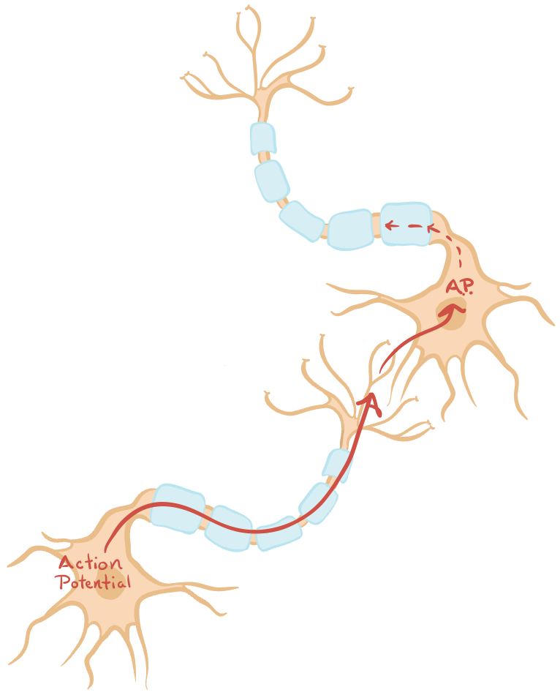
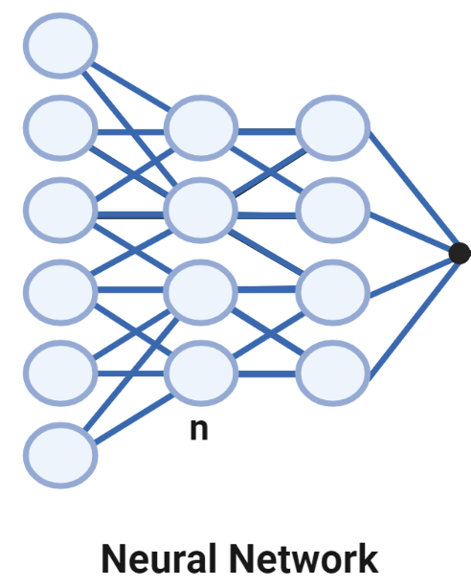
BERT \\ Neural Network

Slide 9
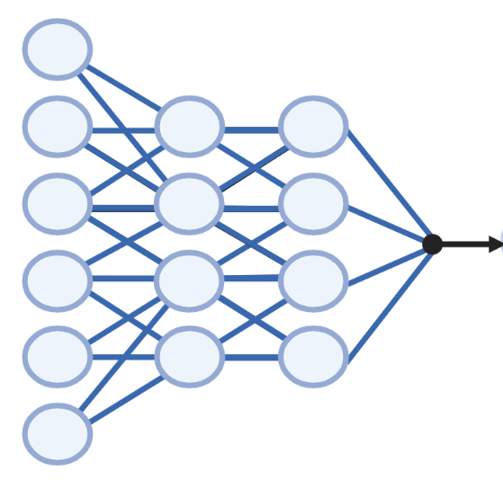
BERT \\ Neural Network
Dog
[0.42, 0.84, 0.12, 0.81, (…)]
appears
[0.42, 0.84, -0.57, 0.81, (…)]
sick
[0.42, -0.14, 0.15, 0.81, (…)]
[-0.02, 0.11, 0.12, -0.99 (...)]
Probability Generator
because
[0.42, 0.46, 0.12, -0.99, (…)]
not
[0.42, 0.84, 0.-66, 0.76, (…)]
Updated
Weights
Loss Function
Alive
62%
eating
[0.49, 0.24, 0.12, 0.21, (…)]
Dead
[0.12, 0.44, 0.62, -0.29 (...)]

Slide 10
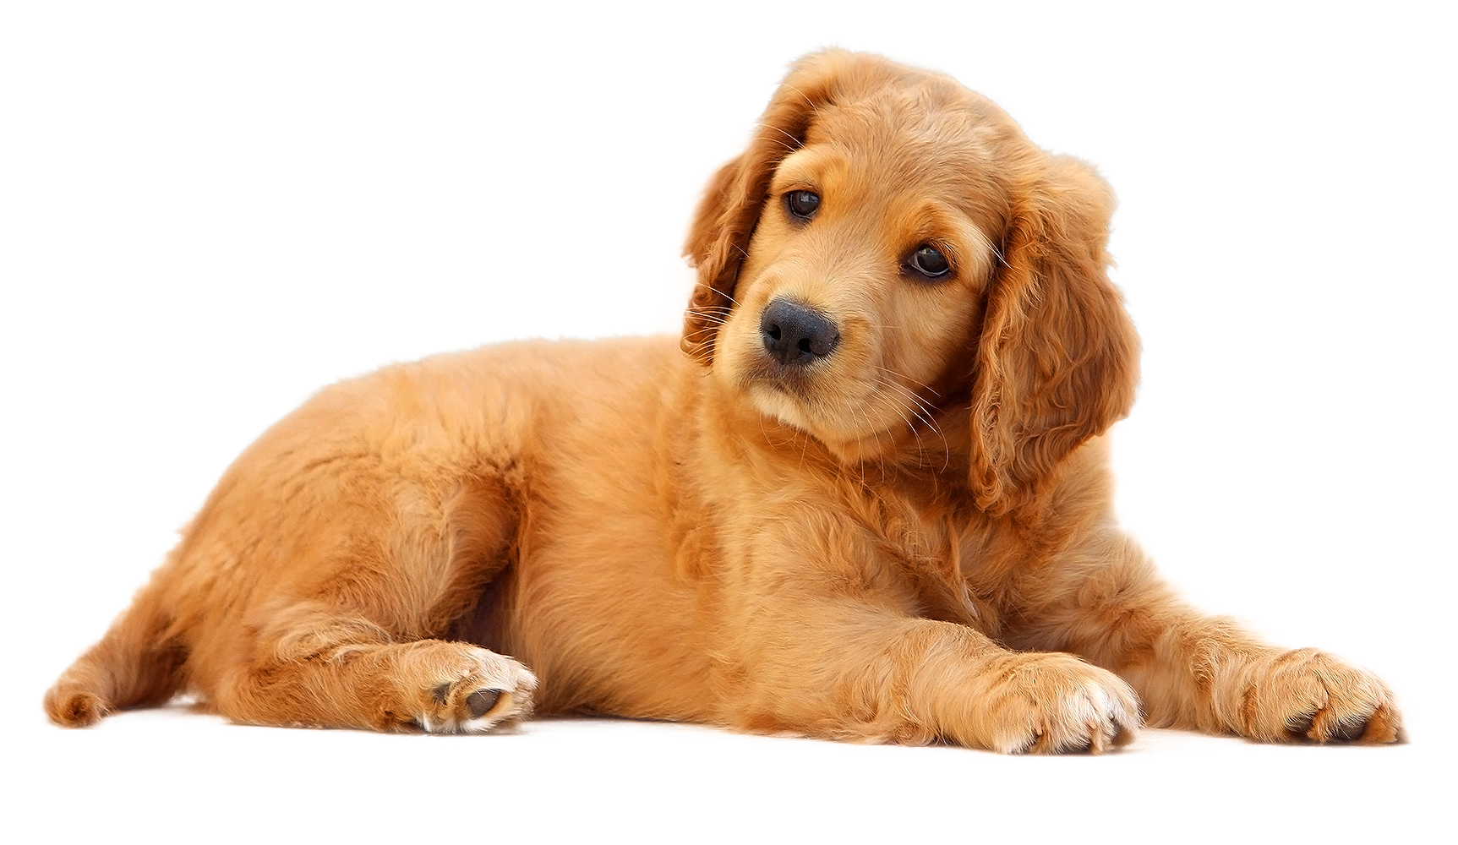
Can AI tell you when your
pet will die?
Sean Farrell

Slide 11
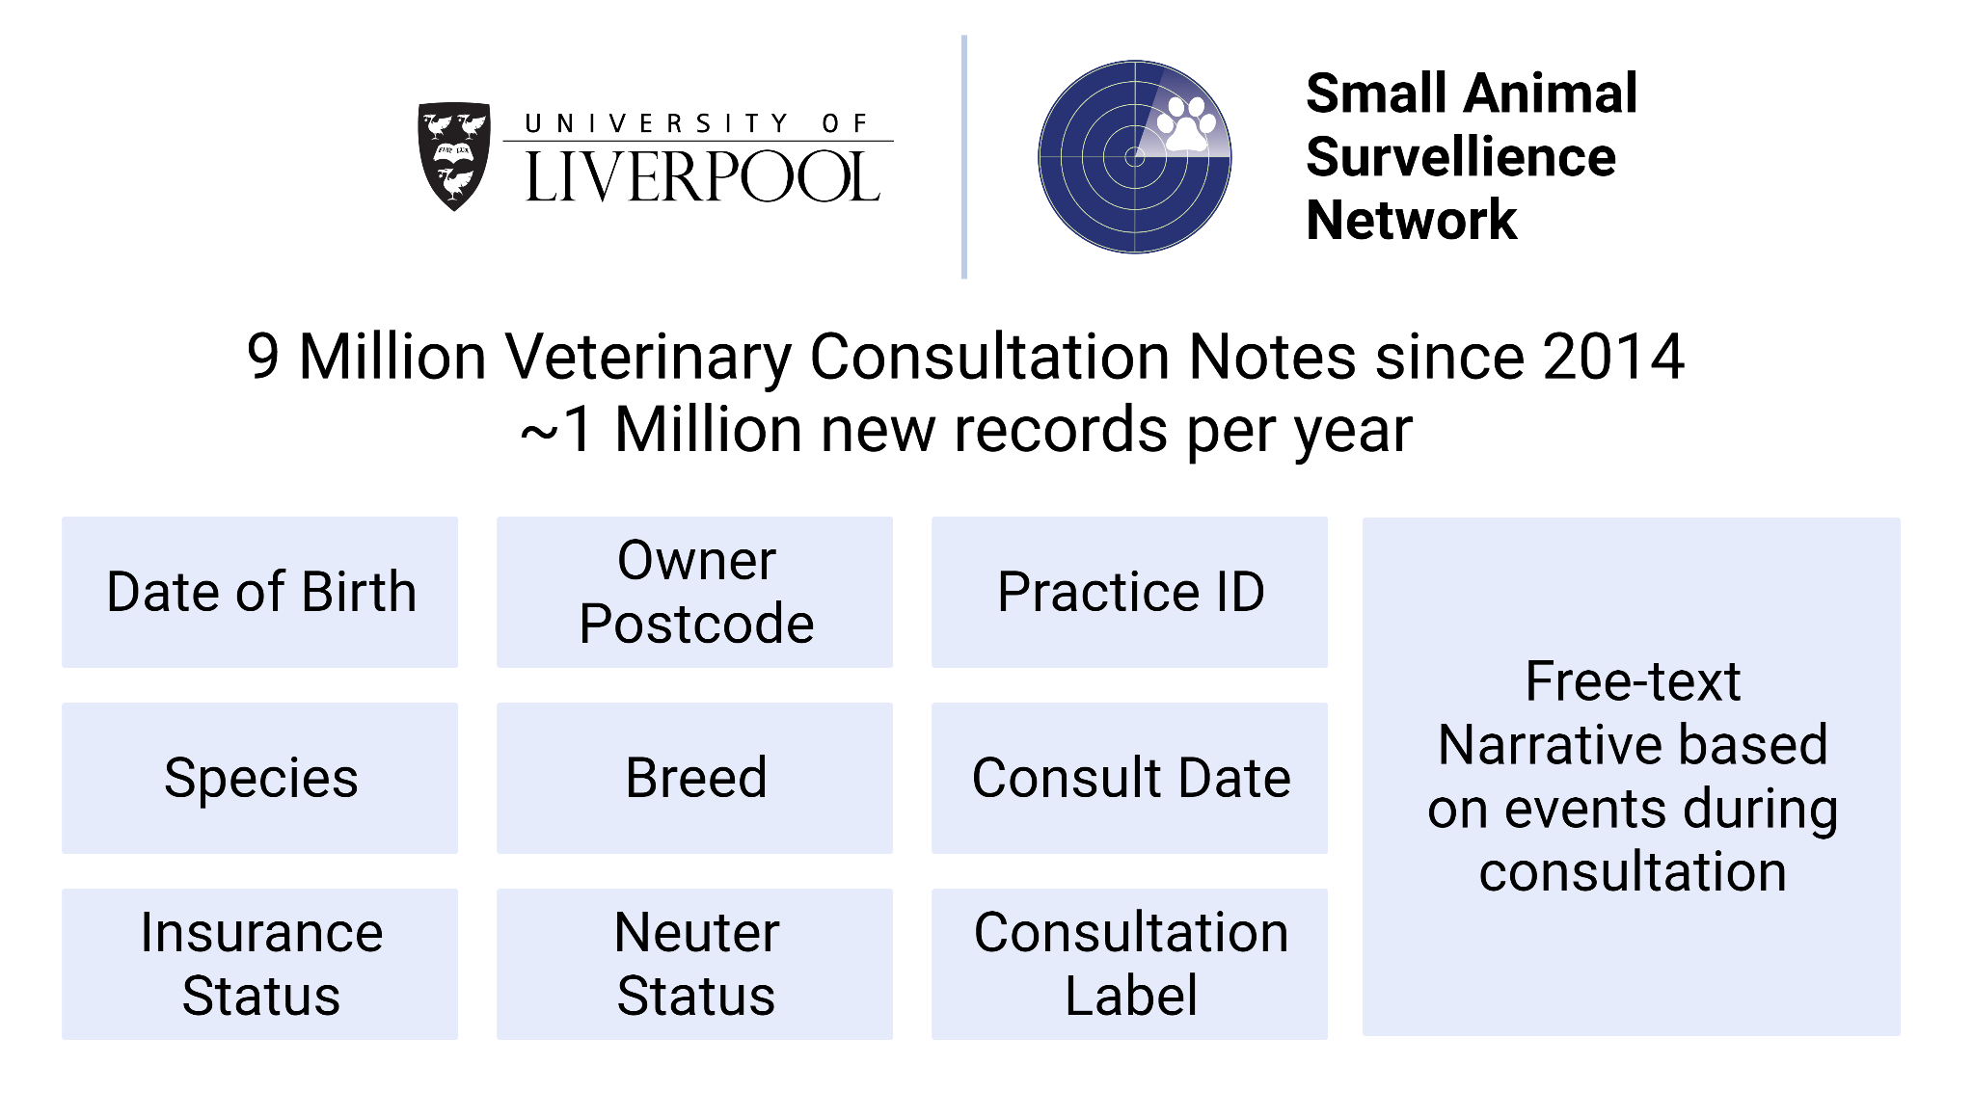
~9 million Veterinary Consultation Records since 2014
~1 million new records each year

Slide 12
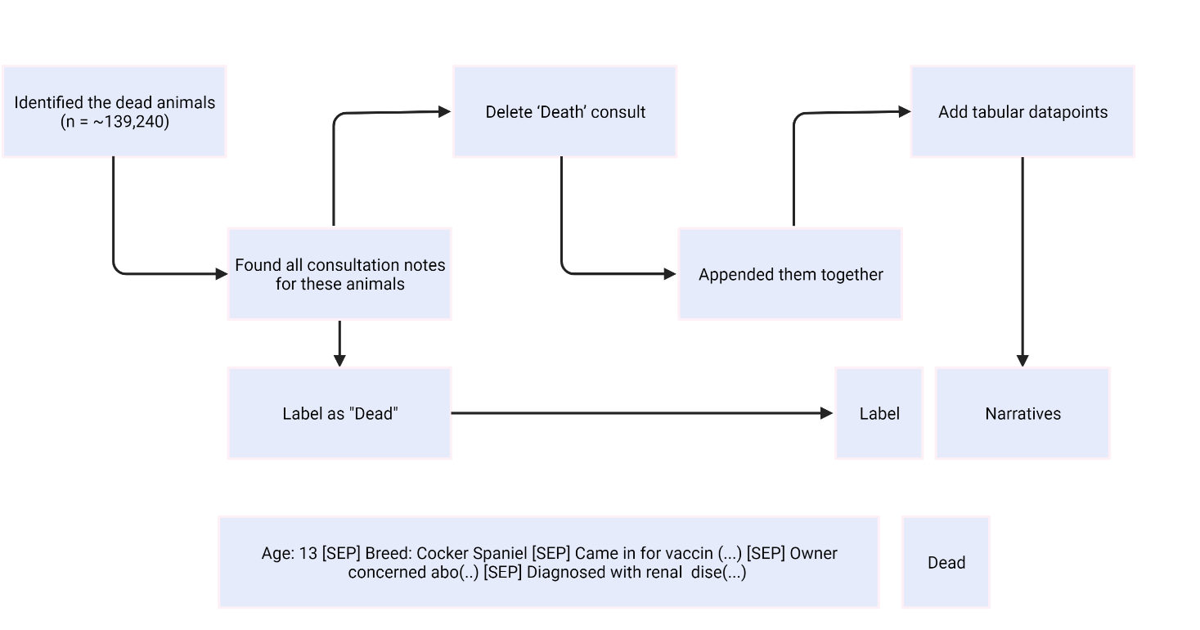

Slide 13
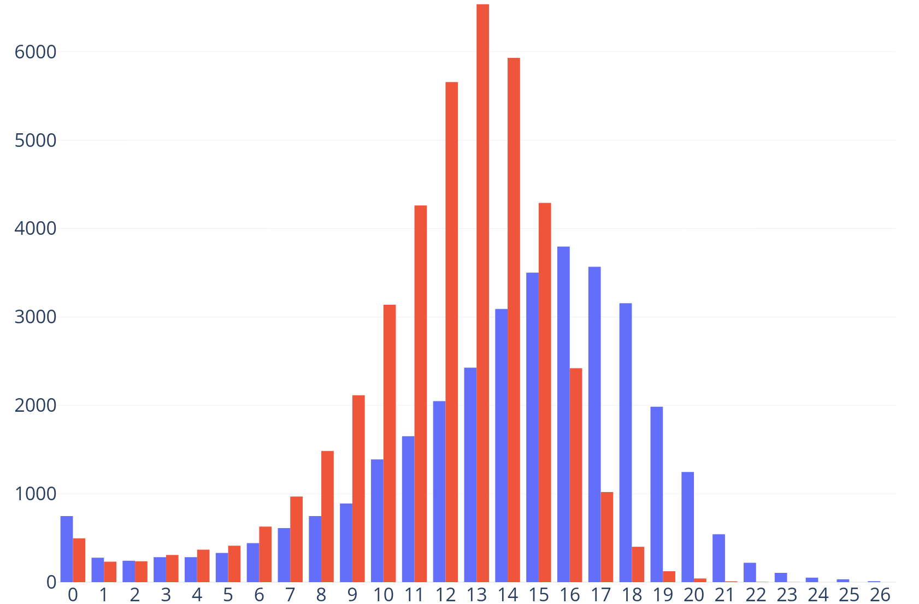
Death Predictor \\ Results \\ Age
Puppy [SEP] Presented with high fever and cough, suspected pneumonia prescribed amoxicillin.
19.1%
Senior [SEP] Presented with high fever and cough, suspected pneumonia prescribed amoxicillin.
79.1 %
Number of Deaths
Puppy [SEP] Has not urinated for 2 days, suspected kidney failure
97.3%
Age (years)
Senior [SEP] Has not urinated for 2 days, suspected kidney failure
97.3%
Dogs
Cats

Slide 14
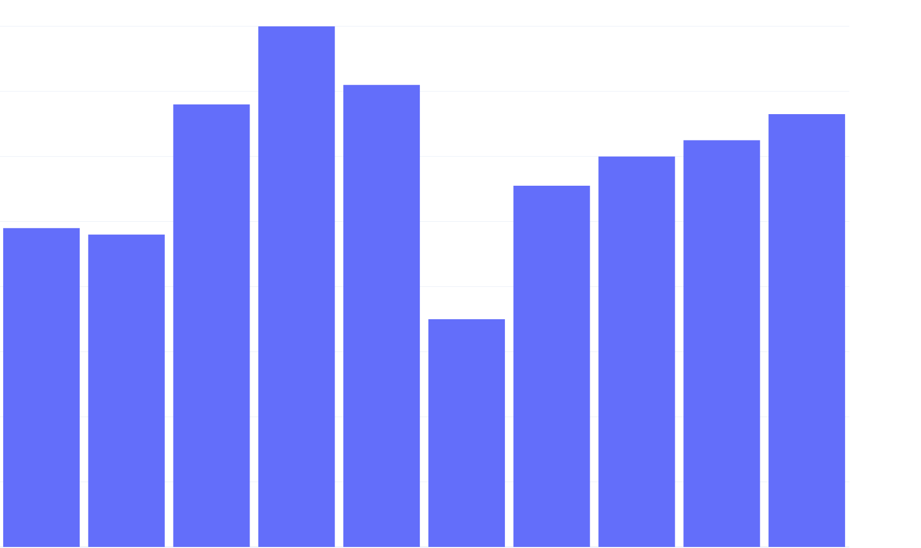
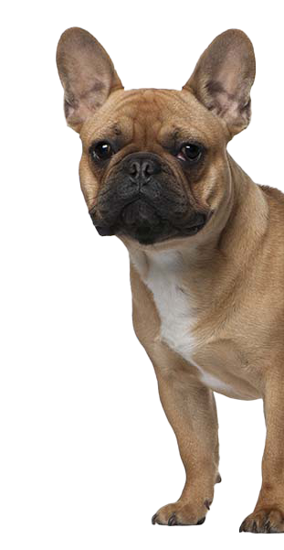
Death Predictor \\ Results \\ Dog \\ Breeds
1.6
1.4
1.2
1.0
0.8
0.6
0.4
0.2
0.0
Jack Russel [SEP] Presented with high fever and cough, suspected pneumonia prescribed amoxicillin.
9.1%
French Bulldog [SEP] Presented with high fever and cough, suspected pneumonia prescribed amoxicillin.
62.1 %
Labrador
Crossbreed
Jack Russel
Border Collie
Yorkshire Terrier
Cocker Spaniel
German Shepherd
Staffordshire Terrier
Springer Spaniel
West highland White Terrier

Slide 15
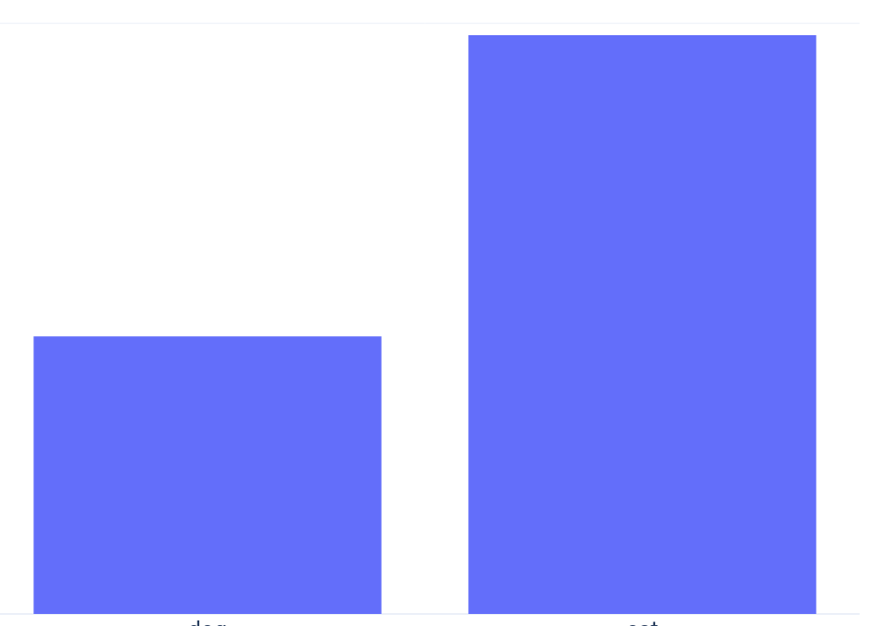
Death Predictor \\ Results \\ Species
2
0
Domestic Short Hair [SEP] Diagnosed with Feline Leukaemia Virus .
97.2%
% of Deaths
Terrier [SEP] Diagnosed with Feline Leukaemia Virus .
9.1 %
Age (years)
Dogs
Cats

Slide 16
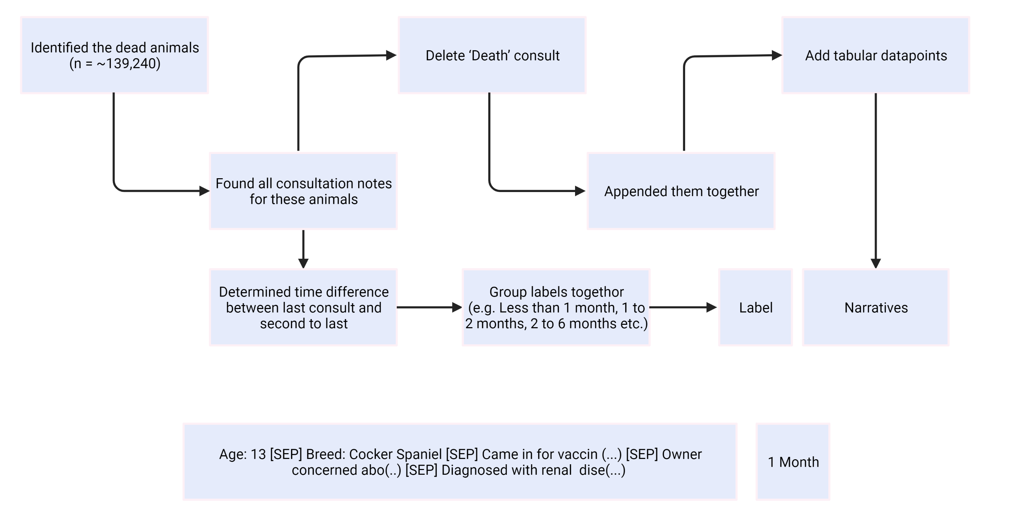

1 Month
2 to 6 Months
> 6 Months

Slide 17
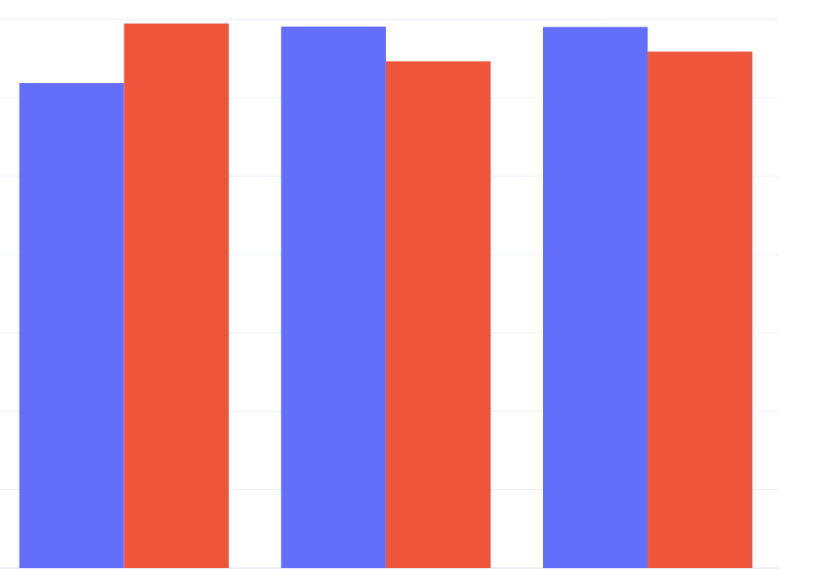
Death Predictor \\ Results \\ Time Left
35
30
25
20
15
10
5
0
Less than 1 Month
2 to 6 Months
>6 Months
Beagle [SEP] Senior [SEP] Presented with high fever and cough, suspected pneumonia prescribed amoxicillin.
>6 Months
Beagle [SEP] Senior [SEP] Has not urinated for 2 days, suspected kidney failure due to renal cell carcinoma.
Less than 1 Month
Dogs
Cats

Slide 18
Death Predictor \\ Study Flaws
True number of dead animals not known
Dataset is too young for “full life” analysis
No real use outside of internal data management
No treatment success analysis
No disease specific analysis
Veterinary Medicine is Privatised.
Treatment availability ≠ Treatment Accessibility
No results shown here are not already aware in Veterinary Medicine
Teaches AI methods to kill our pets
Far too many variable combinations and assumptions
Time groupings based on most recent consultations; should be from diagnosis
No treatment success analysis

Slide 19
[ BioRender object ]
Thanks.
Sean Farrell

